Slide 1



Arvind Kharwal
http://www.kharwal.com

Slide 2
Introduction to Matplotlib

Slide 3
What is Data Visualization?
Data visualization is the graphical representation of information and data.
Data Visualization tools provide an easy way to see and understand trends, outliers, and patterns in data with the help of visual elements like charts, graphs, and maps.
Data visualization is a quick, easy way to convey concepts in a universal manner – and you can experiment with different scenarios by making slight adjustments.

Slide 4
Why Data Visualization?
Human brain can process information easily when it is in pictorial or graphical form.
Data Visualization allows us to quickly interpret the data and adjust different variables to see their effects.
One of the greatest benefits of visualization is that it allows us visual access to huge amounts of data in easily digestible visuals.

Slide 5
It helps decision makers to see analytics presented visually, so they can understand difficult concepts or identify new patterns.
With interactive visualization, we can take the concept a step further by using technology to drill down into charts and graphs for more detail, interactively changing what data you see and how it’s processed.

Slide 6
What is Matplotlib?
The Matplotlib is an amazing visualization library used for 2D graphics.
It was developed by John Hunter in the year 2002.
Matplotlib is a multi-platform data visualization library built on Numpy and designed to work with the SciPy.

Slide 7
Matplotlib is a comprehensive library for creating static, animated, and interactive visualizations in Python.
Matplotlib consists of several plots like line, bar, scatter, histogram etc.
Matplotlib can be used in Python scripts, the Python and IPython shell, web application servers, and various graphical user interface toolkits.

Slide 8
Why use Matplotlib?
In Matplotlib, we can create static 2D plots, which could be useful for scientific publications and presentations.
Almost any plot created in Microsoft Excel can be created with Matplotlib.
Matplotlib can also be used to make 3D plots and animations.

Slide 9
Arvind Kharwal
http://www.kharwal.com

Slide 10
Introduction to Matplotlib

Slide 11
What is Data Visualization?
Data visualization is the graphical representation of information and data.
Data Visualization tools provide an easy way to see and understand trends, outliers, and patterns in data with the help of visual elements like charts, graphs, and maps.

Slide 12
Why Data Visualization?
Human brain can process information easily when it is in pictorial or graphical form.
Data Visualization allows us to quickly interpret the data and adjust different variables to see their effects.
One of the greatest benefits of visualization is that it allows us visual access to huge amounts of data in easily digestible visuals.

Slide 13
What is Matplotlib?
The Matplotlib is an amazing visualization library used for 2D graphics.
It was developed by John Hunter in the year 2002.
Matplotlib is a multi-platform data visualization library built on Numpy and designed to work with the SciPy.

Slide 14
Matplotlib consists of several plots like line, bar, scatter, histogram etc.
Matplotlib can be used in Python scripts, the Python and IPython shell, web application servers, and various graphical user interface toolkits.

Slide 15
Why use Matplotlib?
In Matplotlib, we can create static 2D plots, which could be useful for scientific publications and presentations.
Almost any plot created in Microsoft Excel can be created with Matplotlib.
Matplotlib can also be used to make 3D plots and animations.

Slide 16
Thank You

Slide 17
Types of Plot

Slide 18
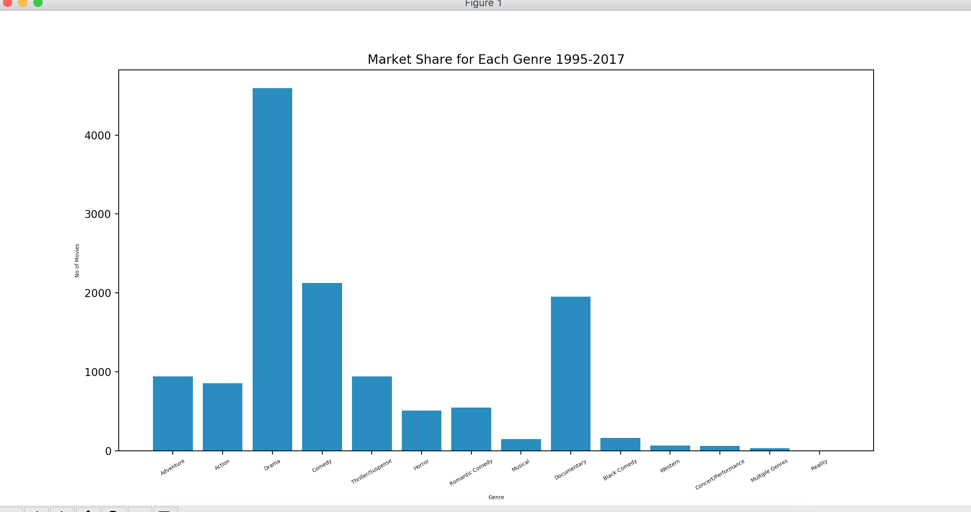
Bar Graph

Slide 19
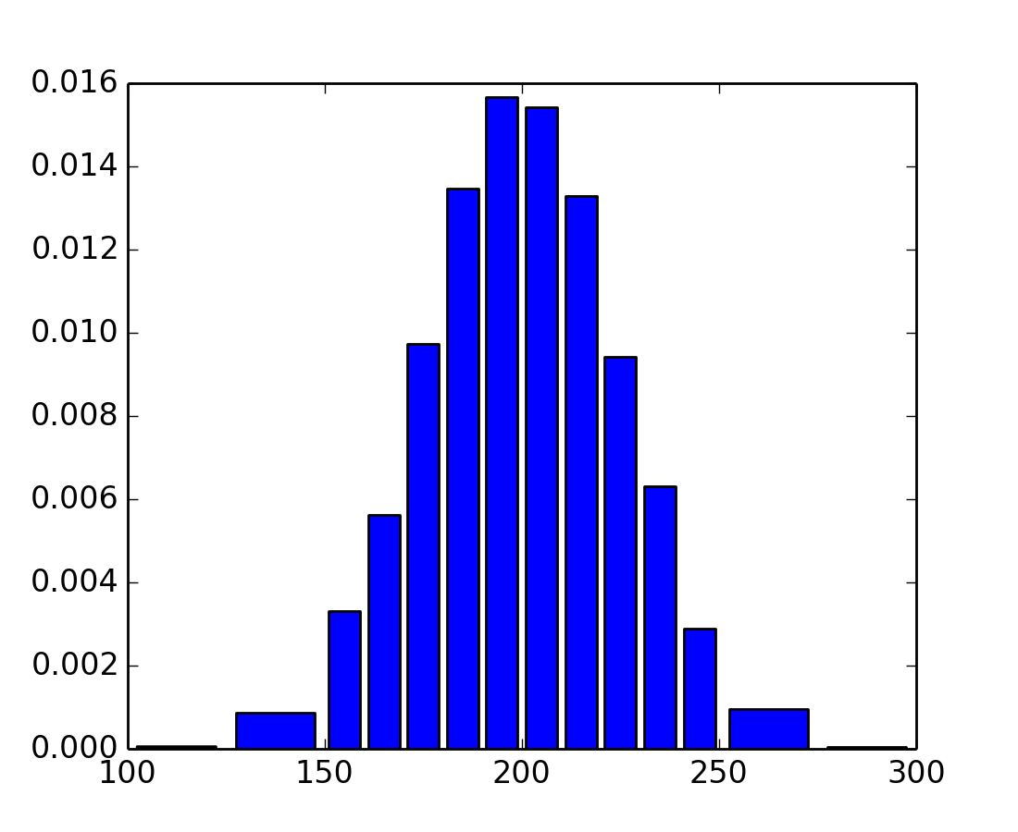
Histogram Graph

Slide 20
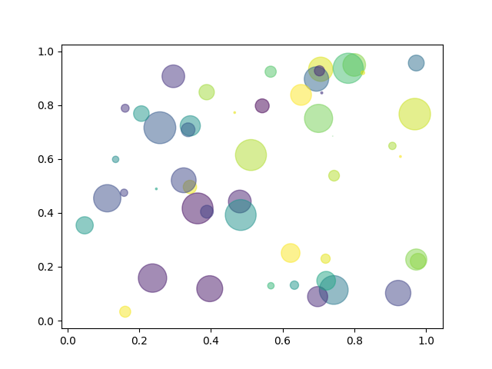
Scatter Plot

Slide 21
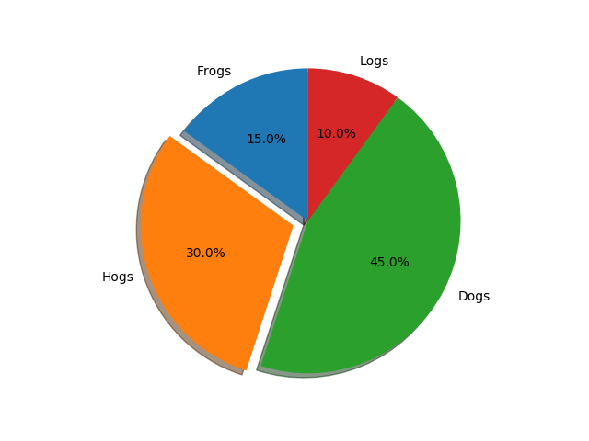
Pie Plot

Slide 22
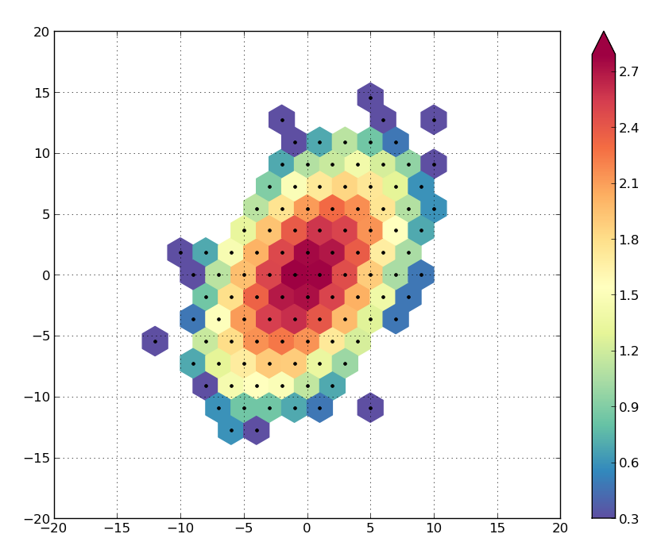
Hexbin Plot

Slide 23
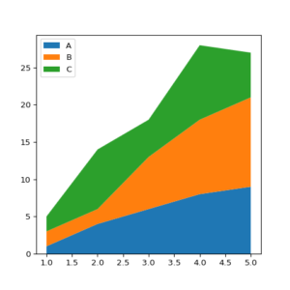
Area Plot

Slide 24
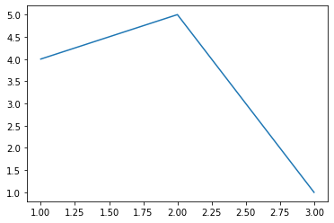
Create First Plot:
from matplotlib import pyplot as plt
plt.plot([1,2,3],[4,5,1])
plt.show

Slide 25
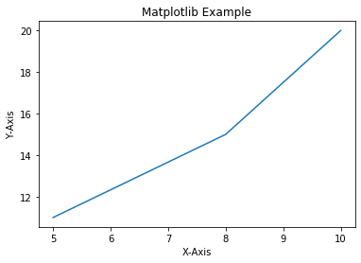
Add Labels and Title to Plot:
from matplotlib import pyplot as plt
x=[5,8,10]
y=[11,15,20]
plt.plot(x,y)
plt.title('Matplotlib Example')
plt.xlabel('X-Axis')
plt.ylabel('Y-Axis')
plt.show()

Slide 26
Add Styles to Plot:
from matplotlib import style
style.use('ggplot')
x1=[5,8,10]
y1=[12,16,23]
x2=[17,13,45]
y2=[15,20,30]
plt.plot(x1,y1,'g',label='Line One',linewidth=5)
plt.plot(x2,y2,'c',label='Line Two',linewidth=5)

Slide 27
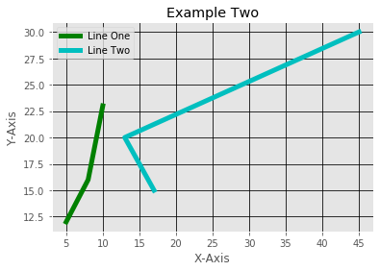
plt.title('Example Two')
plt.xlabel('X-Axis')
plt.ylabel('Y-Axis')
plt.legend()
plt.grid(True,color='k')
plt.show()

Slide 28
Bar Plot:
x1=[5,8,10]
y1=[12,16,23]
x2=[17,13,45]
y2=[15,20,30]
plt.bar(x1,y1,label='Example One')
plt.bar(x2,y2,label='Example Two')
plt.legend()
plt.xlabel('X-axis')
plt.ylabel('Y-axis')

Slide 29
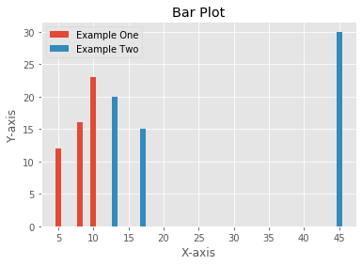
plt.title('Bar Plot')
plt.show()

Slide 30
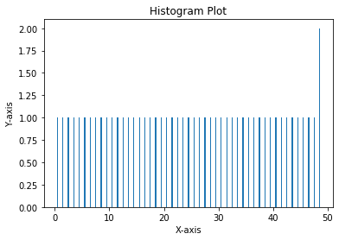
Histogram:
pa=range(50)
bins=range(50)
plt.hist(pa,bins,histtype='bar',rwidth=0.2)
plt.xlabel('X-axis')
plt.ylabel('Y-axis')
plt.title('Histogram Plot')
plt.show()

Slide 31
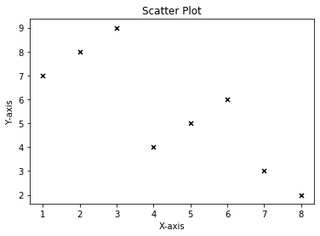
Scatter Plot:
x3=[1,2,3,4,5,6,7,8]
y3=[7,8,9,4,5,6,3,2]
plt.scatter(x3,y3,label='Arvind',color='k',s=25,marker='x')
plt.xlabel('X-axis')
plt.ylabel('Y-axis')
plt.title('Scatter Plot')
plt.show()

Slide 32
Stack Plot:
D=[1,2,3,4,5]
S=[7,8,6,11,7]
E=[2,3,4,3,2]
W=[7,8,7,2,2]
P=[8,5,7,8,13]
plt.plot([],[],color='m',label='D',linewidth=5)
plt.plot([],[],color='c',label='S',linewidth=5)
plt.plot([],[],color='r',label='E',linewidth=5)
plt.plot([],[],color='k',label='W',linewidth=5)
plt.plot([],[],color='g',label='P',linewidth=5)

Slide 33
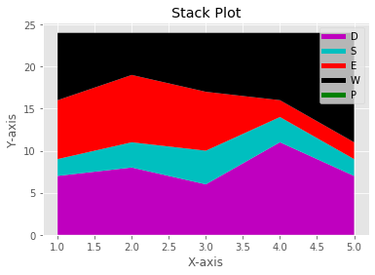
plt.stackplot(D,S,E,W,P,colors=['m','c','r','k','y'])
plt.legend()
plt.xlabel('X-axis')
plt.ylabel('Y-axis')
plt.title('Stack Plot')
plt.show()

Slide 34
Pie Plot:
slices=[7,2,4,3]
Name=['A','B','C','D']
clrs=['c','m','r','b']
plt.pie(slices,
labels=Name,
colors=clrs,
startangle=90,
shadow=True,
explode=(0,0.1,0,0),
autopct='%.2f%%'
)

Slide 35
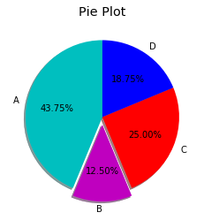
plt.title('Pie Plot')
plt.show()

Slide 36
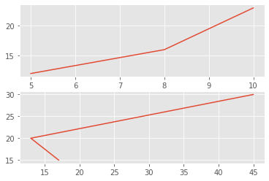
Working With Multiple Plots:
x1=[5,8,10]
y1=[12,16,23]
x2=[17,13,45]
y2=[15,20,30]
plt.subplot(211)
plt.plot(x1,y1)
plt.subplot(212)
plt.plot(x2,y2)
plt.show()

Slide 37
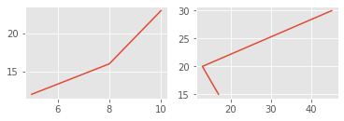
x1=[5,8,10]
y1=[12,16,23]
x2=[17,13,45]
y2=[15,20,30]
plt.subplot(221)
plt.plot(x1,y1)
plt.subplot(222)
plt.plot(x2,y2)
plt.show()

Slide 38
Plt.subplot(211)
2 means we have 2 plots in this plot.
1 means Horizontally we have only one plot
1 means this is plot number 1

